Slide 1
Analysing
New London’s Urban Forest using GIS
Isabelle Smith, Connecticut College

Slide 2
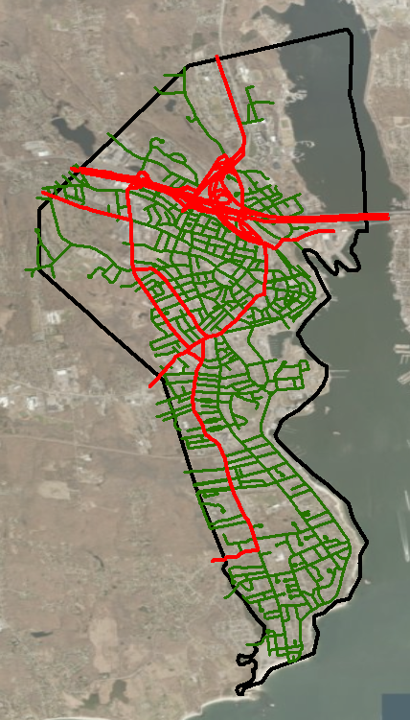
Background
City Roads
State Roads
New London received an “America the Beautiful” grant
The Arboretum was contacted to provide know-how
There were many limitations to the study
GIS allowed for analysis

Slide 3
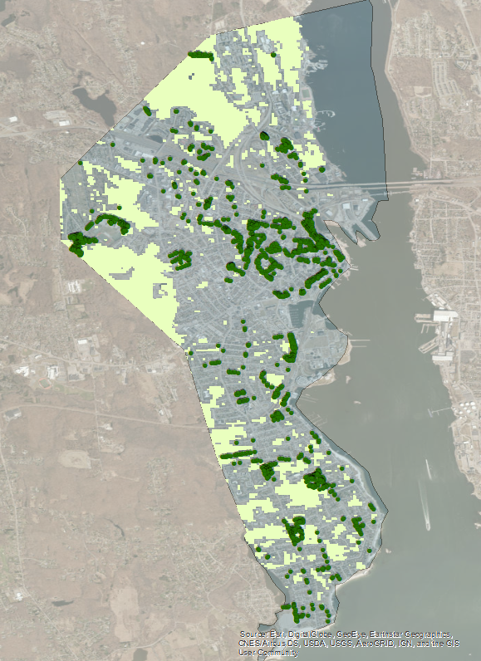
Preliminary Study
Overall Vegetation
30 years of data (1974-2014)
Iso-clusters
Overlay trees and year groupings

Slide 4
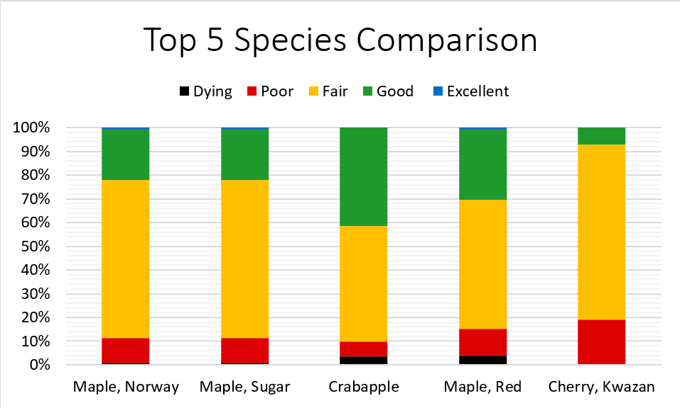
Species Conditions
Selecting Attributes
Exporting selected data

Slide 5
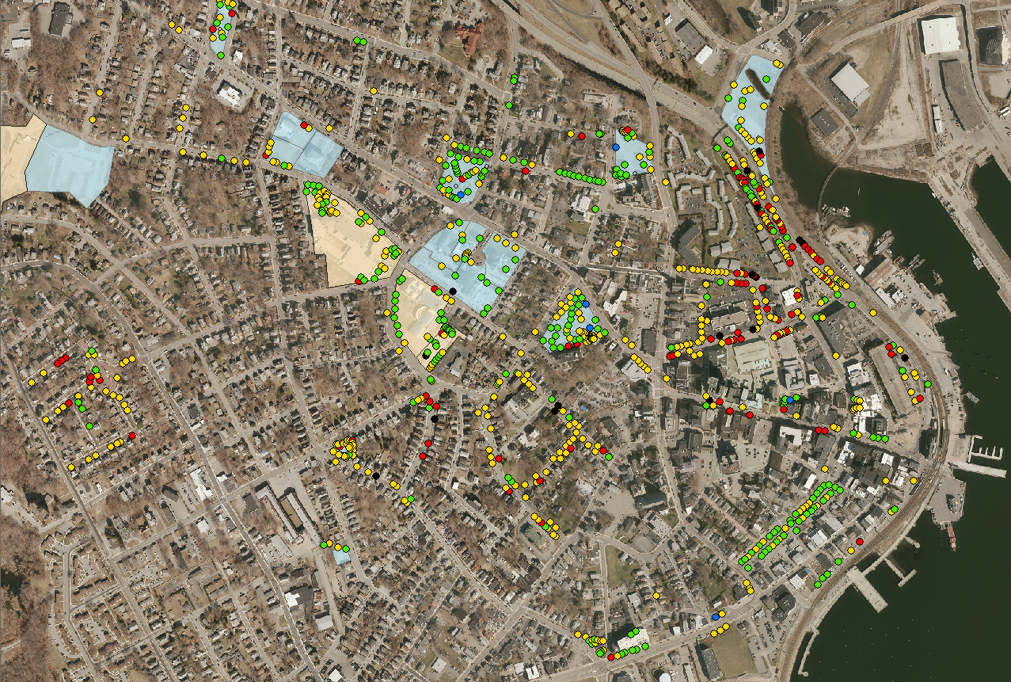
Conditions
Downtown
Dead/ Dying
Poor
Fair
Good
Excellent
Parks
Schools
Visualize condition based on location
Overlayed town properties with tree conditions

Slide 6
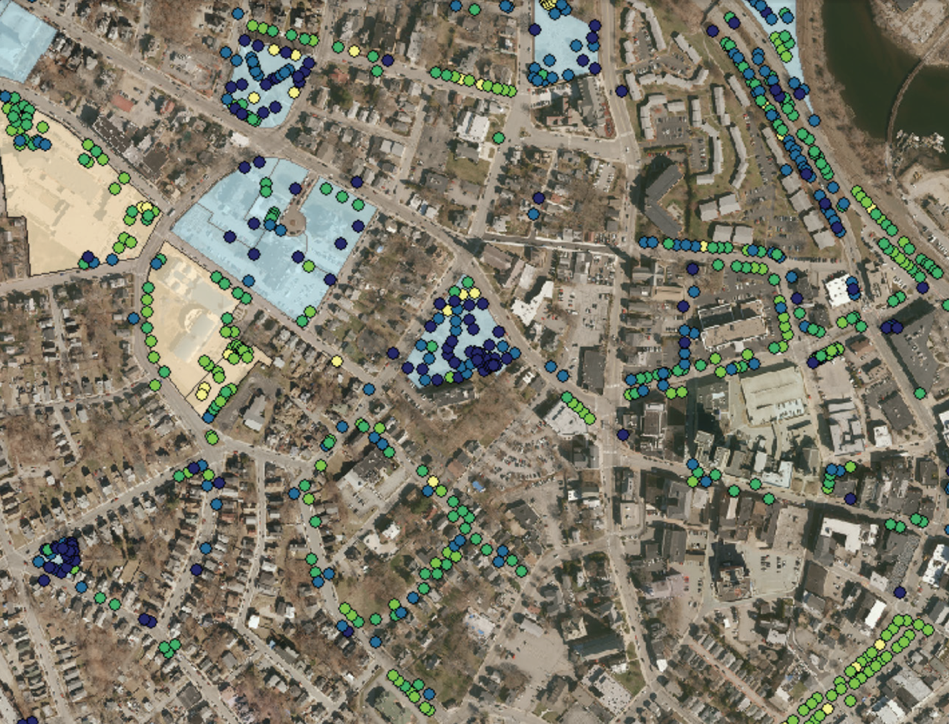
Height Expectations
According to the Manual of Woody Landscape Plants by Michael Dirr
Actual height divided by expected height
Using the Field Calculator and multiple Attributes

Slide 7
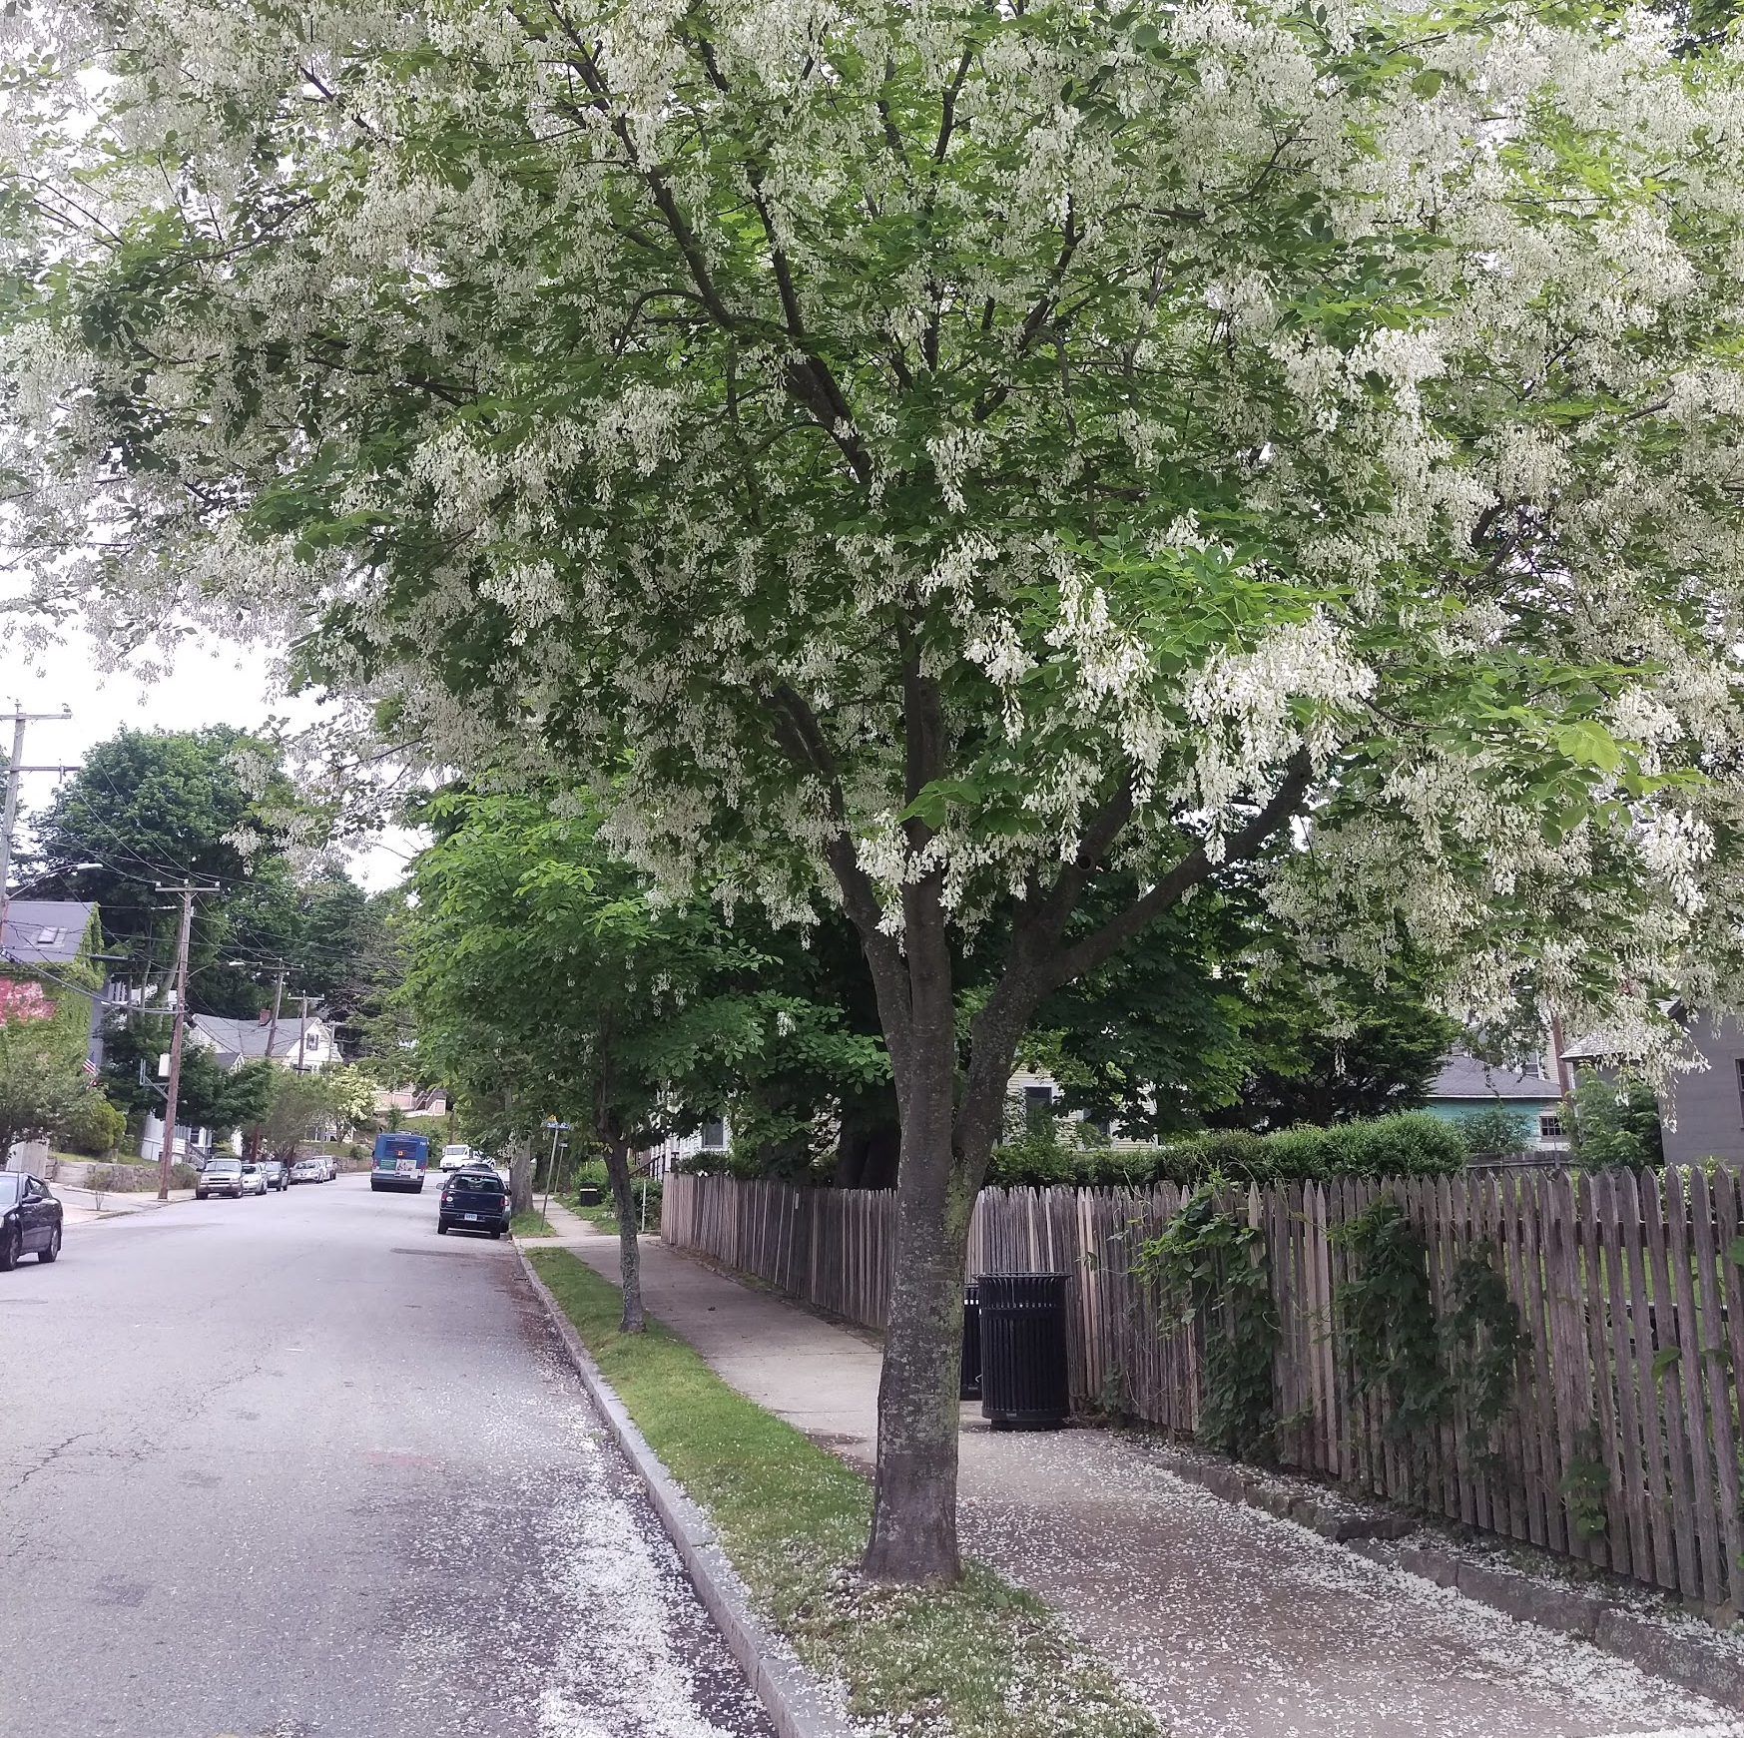
Canopy Cover
NL canopy cover is about 25% (Aerial photographs)
Inventory only surveyed 2.4% of total canopy (Trees buffered and geometry calculated)
Photo Credit: Maggie Redfern
Yellowwood, Hempstead St

Slide 8
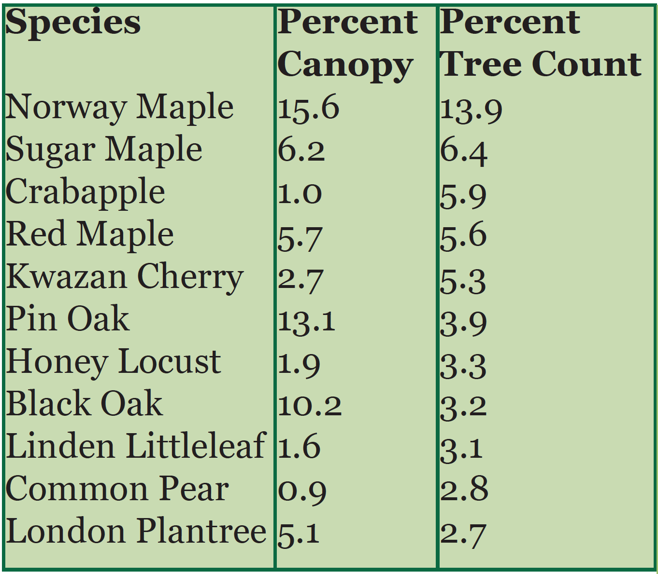
Specific
Contributions
Calculated each tree’s canopy coverage
Used “Select by” feature
Compared tree count by species to contribution to municipal canopy
Top eleven most commonly planted species

Slide 9
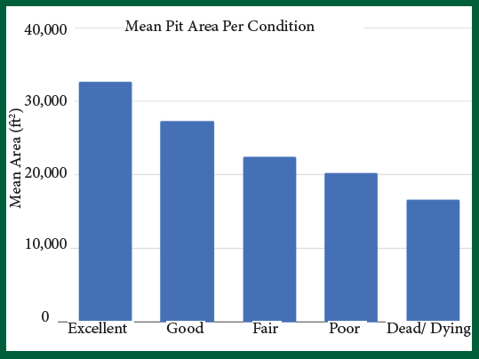
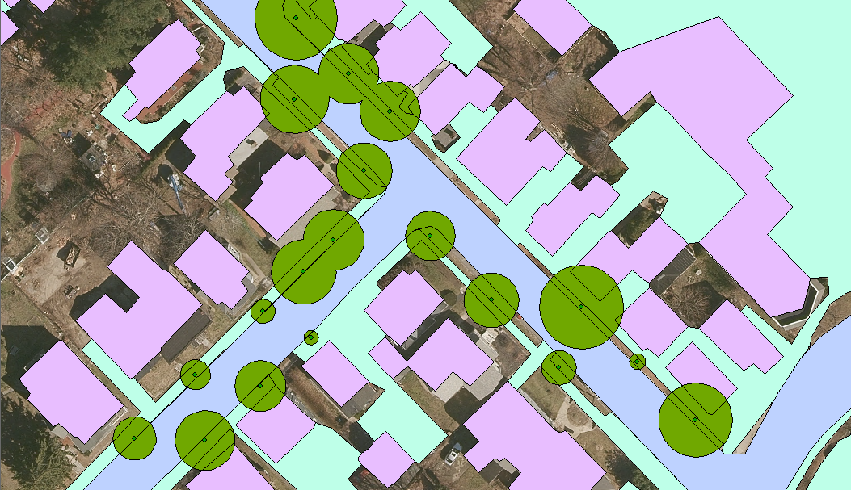
Tree health by planting strip size

Slide 10
Thank you,
Beverly Chomiak

