Slide 1
Examining Distributions of Arsenic and Uranium in Domestic Wells Within the Deep River Quadrangle
Bryce Mase and Meredith Metcalf
Eastern Connecticut State University
CT GIS User-to-User Network Meeting, March 2019
Notes:
©This presentation and the content contained herein are the property of the author and shall not be copied, used, or implemented in part or in whole without the expressed written consent of the author.

Slide 2
Groundwater
Conclusions
Groundwater is one of the most valuable natural resources on the planet.
Supports human health, economic development and ecological diversity.
Its wide range of uses and applications make it important for groundwater to be clean, usable, and drinkable.
Any contaminants in groundwater can have a large impact on the community that relies on such water.
Results
Methods
Objectives
Background

Slide 3
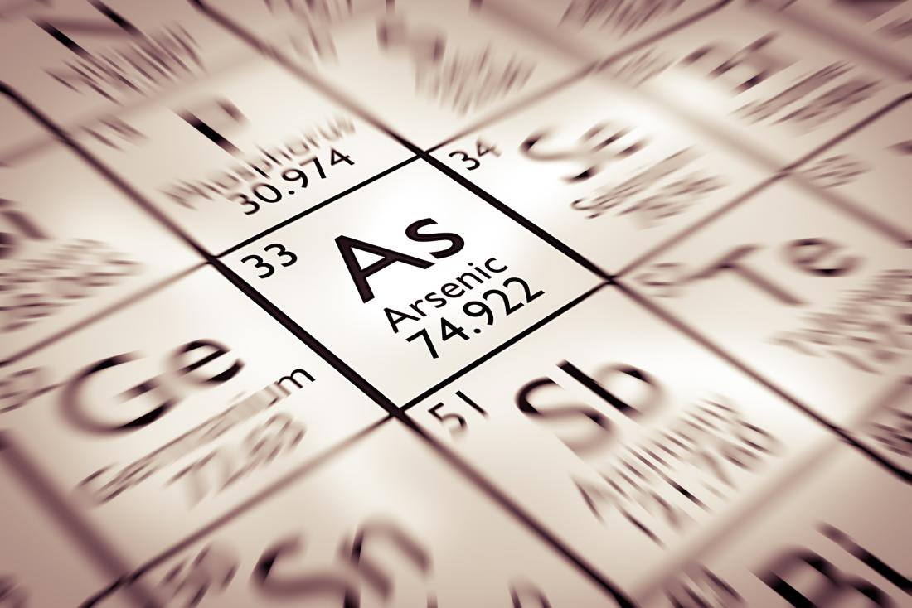
Arsenic and Uranium in GW
Conclusions
Exceeding drinking-water standards in groundwater can have negative impacts on human health.
High concentrations of arsenic in drinking water have been associated with increased risk of lung, bladder, and skin cancers.
Uranium in drinking water has been associated with negative effects on kidney function.
Results
Methods
Objectives
Background

Slide 4
Sources of Arsenic
Conclusions
Pesticides:
Paris Green (copper acetoarsenite) – 1860’s to 1900.
London Purple ( calcium arsenite) – 1860’s to 1900.
Lead arsenate, late 1800’s to 1960.
Wood Preservative, chromated copper arsenate – 1970’s to today.
Embalming fluid – 1860’s to 1910.
Landfills containing arsenic waste products.
Poultry manure (four organoarsenic compounds for animal feed additive) – 1940’s to 2013 (3 removed, 1 suspended in 2015).
Rocks with arsenopyrite.
Results
Methods
Objectives
Background

Slide 5
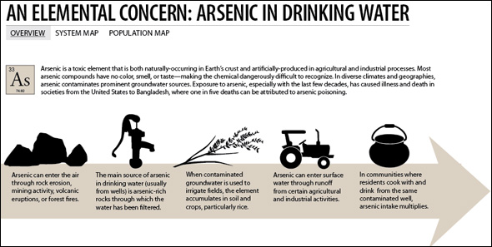
Recent Studies (Arsenic)
Conclusions
Report historic agricultural practices do not significantly contribute to current arsenic concentrations in groundwater.
Conclude natural occurrences can be due to interaction of arsenic-bearing minerals within the aquifer with groundwater.
These studies contradict our findings at a more local scale.
Results
Methods
Objectives
Background

Slide 6
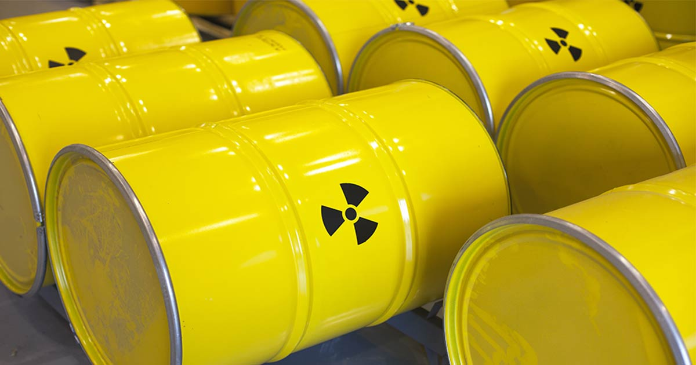
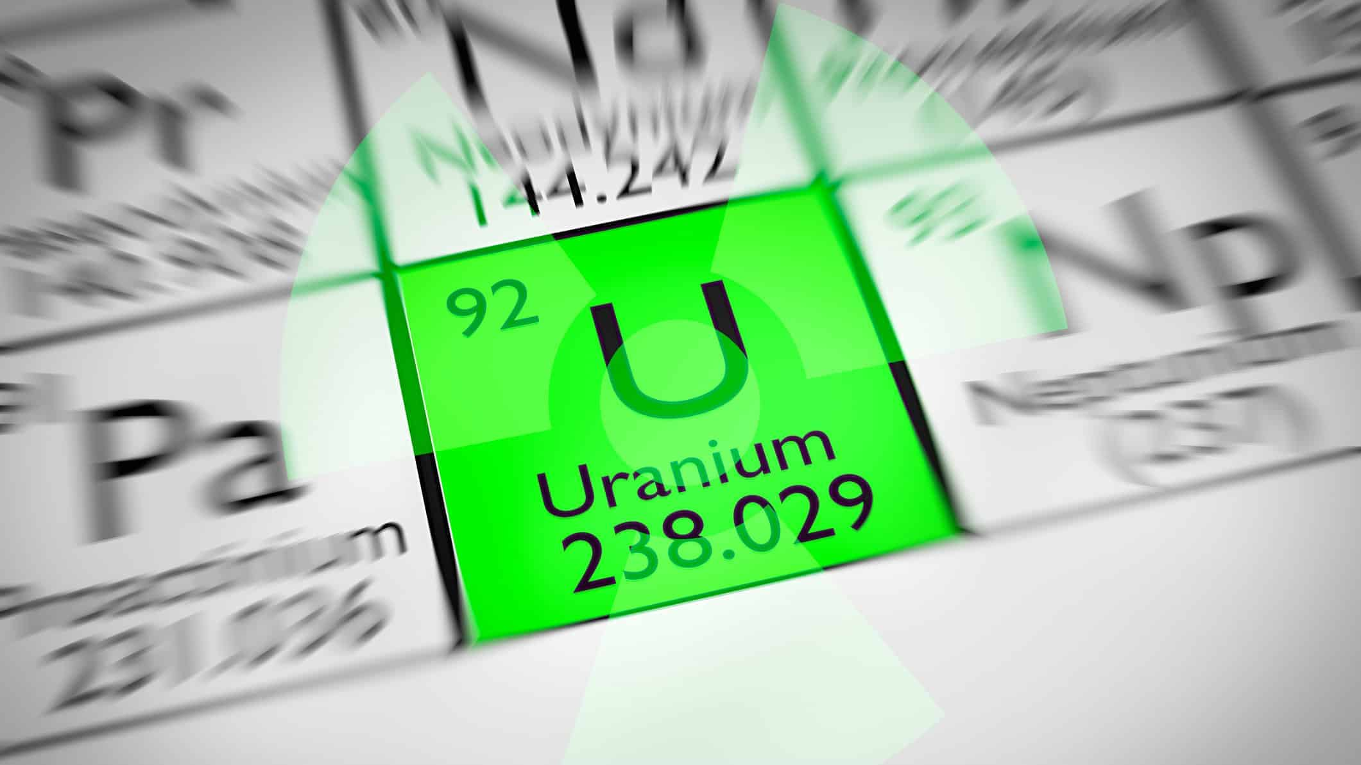
Early Studies (Uranium)
Conclusions
Naturally occurring element, present in the earth’s crust due to radioactive decay.
Previous studies reported uranium forms soluble complexes, particularly with carbonates under oxygen-rich conditions.
It precipitates from ground water under oxygen-poor conditions
Results
Methods
Objectives
Background

Slide 7
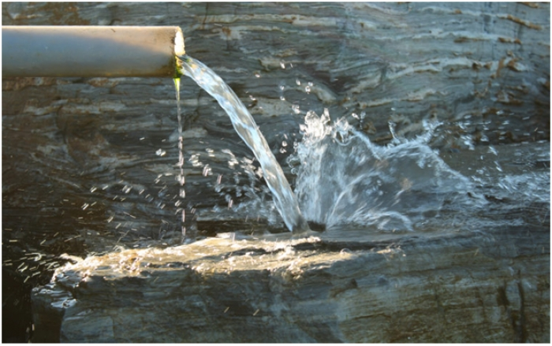
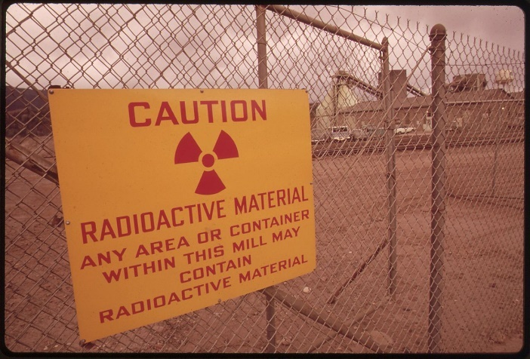
Recent Studies (Uranium)
Conclusions
Natural occurrences of uranium can be due to interaction of uranium-bearing minerals within the aquifer with groundwater.
The concentration of uranium in water and bedrock is expected to range widely due to different geochemical environments.
Important to consider dissolved oxygen levels (DO) when analyzing uranium concentrations.
Results
Methods
Objectives
Background

Slide 8
New England
Conclusions
Arsenic and uranium in GW - strong association to geology.
New Hampshire and Massachusetts-
Exceedances have shown distinct spatial patterns to lithology.
Results
Methods
Objectives
Background

Slide 9
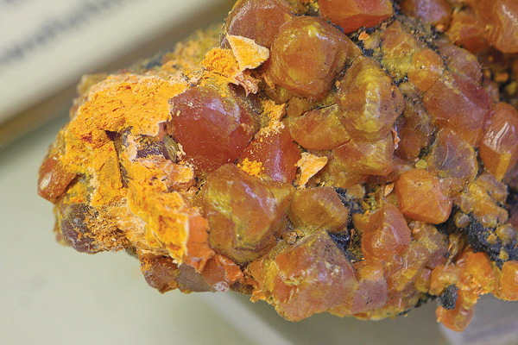
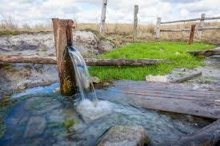
Connecticut
Conclusions
CT DPH: Over 300,000 residential wells in CT, serving approximately 23% of the State’s population.
CT does not require homeowners to routinely test.
USGS: Previous research on arsenic and uranium distributions show underlying geology is the source of the contaminants.
Results
Methods
Objectives
Background

Slide 10
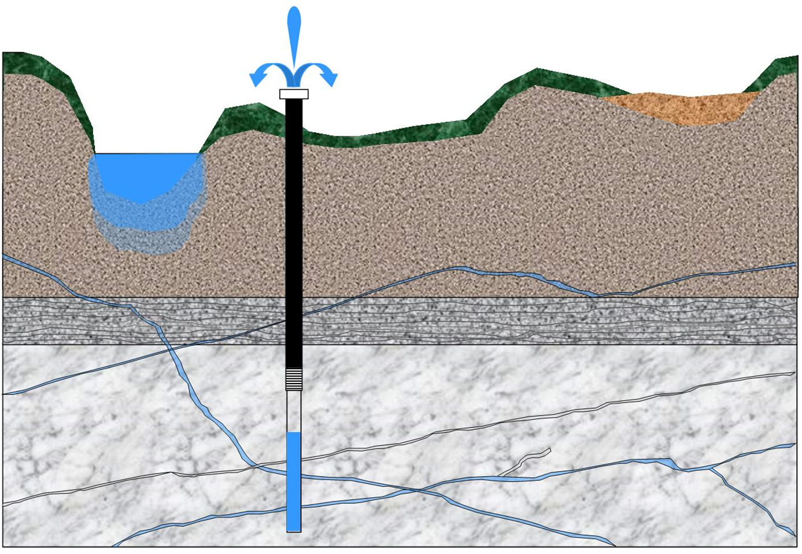
Connecticut (cont.)
Conclusions
However, there is no statistical evidence to suggest underlying geology contributes to observed water quality conditions given the complexities of groundwater flow.
Results
Methods
Objectives
Background

Slide 11
Our Study
Conclusions
In the summer of 2018, the USGS began mapping the bedrock in detail for the Deep River Quadrangle of Connecticut.
Included most recent/accurate identification of the extent of bedrock fractures, mineralogical analyses, bedrock geochemistry.
Results
Methods
Objectives
Background

Slide 12
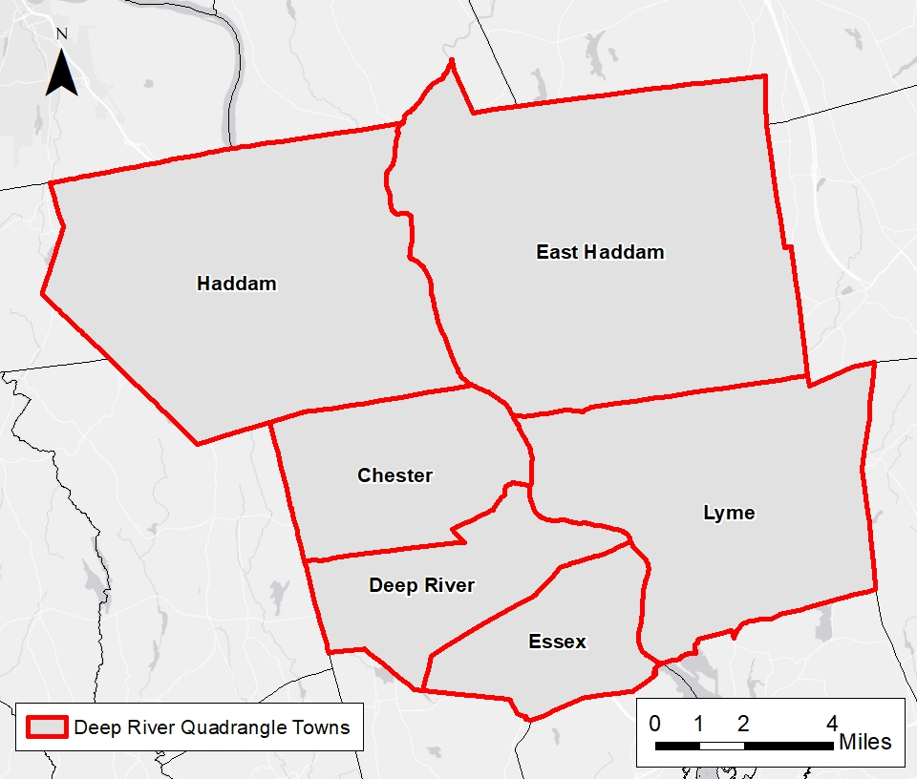
Study Site: Connecticut Deep River Quadrangle
Conclusions
The Deep River Quadrangle includes Haddam, East Haddam, Chester, Deep River, Essex, and Lyme.
Results
Methods
Objectives
Background

Slide 13
Study Objectives
Conclusions
With the updated mapping, a more accurate representation of the relationship between arsenic and uranium occurrences to bedrock geology can be studied.
Examine the spatial distribution of arsenic and uranium concentrations in fractured bedrock wells to:
Support or refute previous studies indicating underlying bedrock influences the concentration observed in drinking water.
Assist the Department of Public Health to:
Identify potential sources given the distribution of arsenic in bedrock wells.
Results
Methods
Objectives
Background

Slide 14
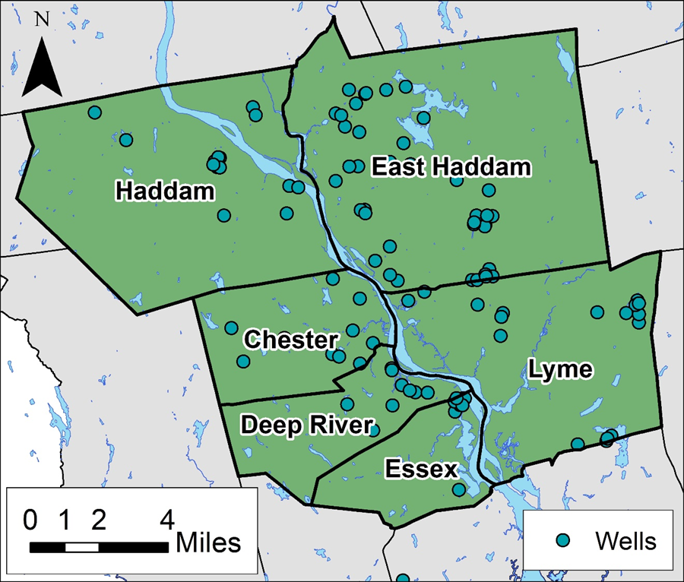
Sample Distribution
Conclusions
A random distribution of ~100 wells was sampled.
Critical water quality parameters were recorded in the field.
Samples sent to DPH to analyze traditional water quality parameters, as well as a variety of metals.
Results
Methods
Objectives
Background

Slide 15
Sample Distribution
Conclusions
Majority of wells analyzed were distributed in close proximity to the Connecticut River.
Location of wells sampled:
East Haddam: 40%
Lyme: 17%
Haddam: 14%
Chester: 10%
Deep River: 9%
Essex: 8%
2% of wells located outside of the Deep River Quadrangle.
Results
Methods
Objectives
Background

Slide 16
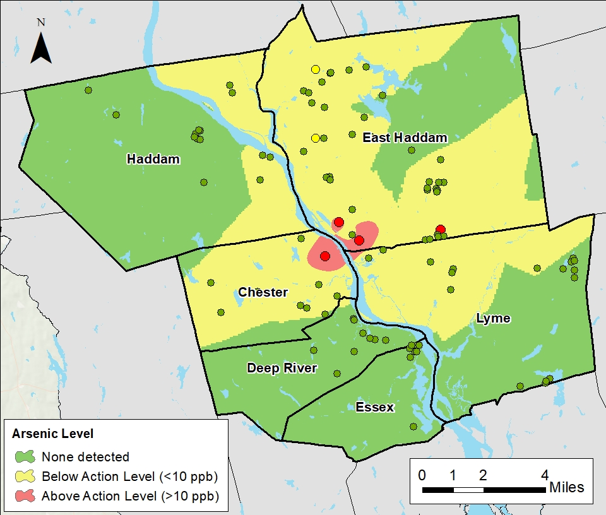
Arsenic Distribution
Conclusions
Arsenic Concentrations:
Minimum: non-detect
Maximum: 35 ppb
Average: 3.8 ppb
Present in 7% of wells
4% exceeded standard.
Results
Methods
Objectives
Background

Slide 17
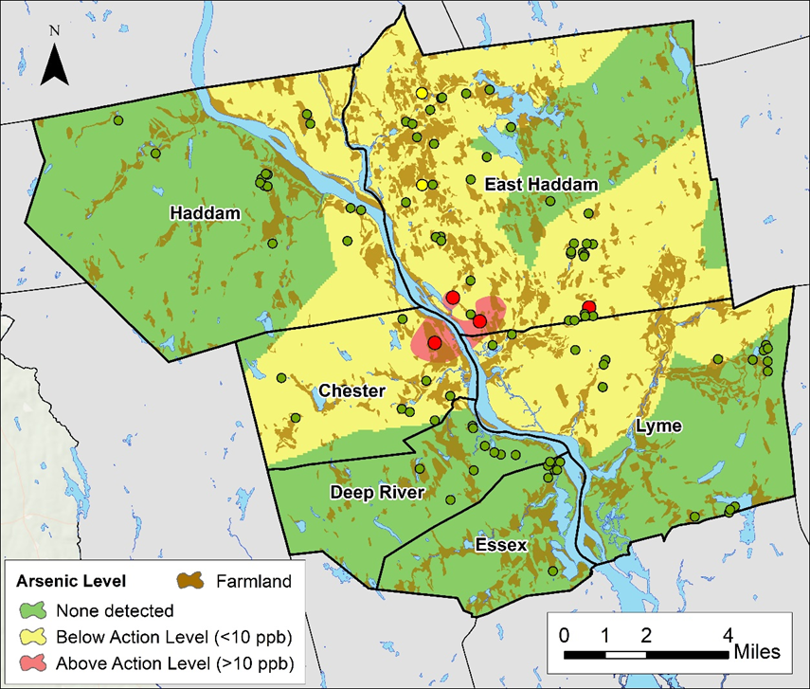
Arsenic Distribution
Conclusions
Arsenic Concentrations:
Minimum: non-detect
Maximum: 35 ppb
Average: 3.8 ppb
Present in 7% of wells
4% exceeded standard.
Results
Methods
Objectives
Background

Slide 18
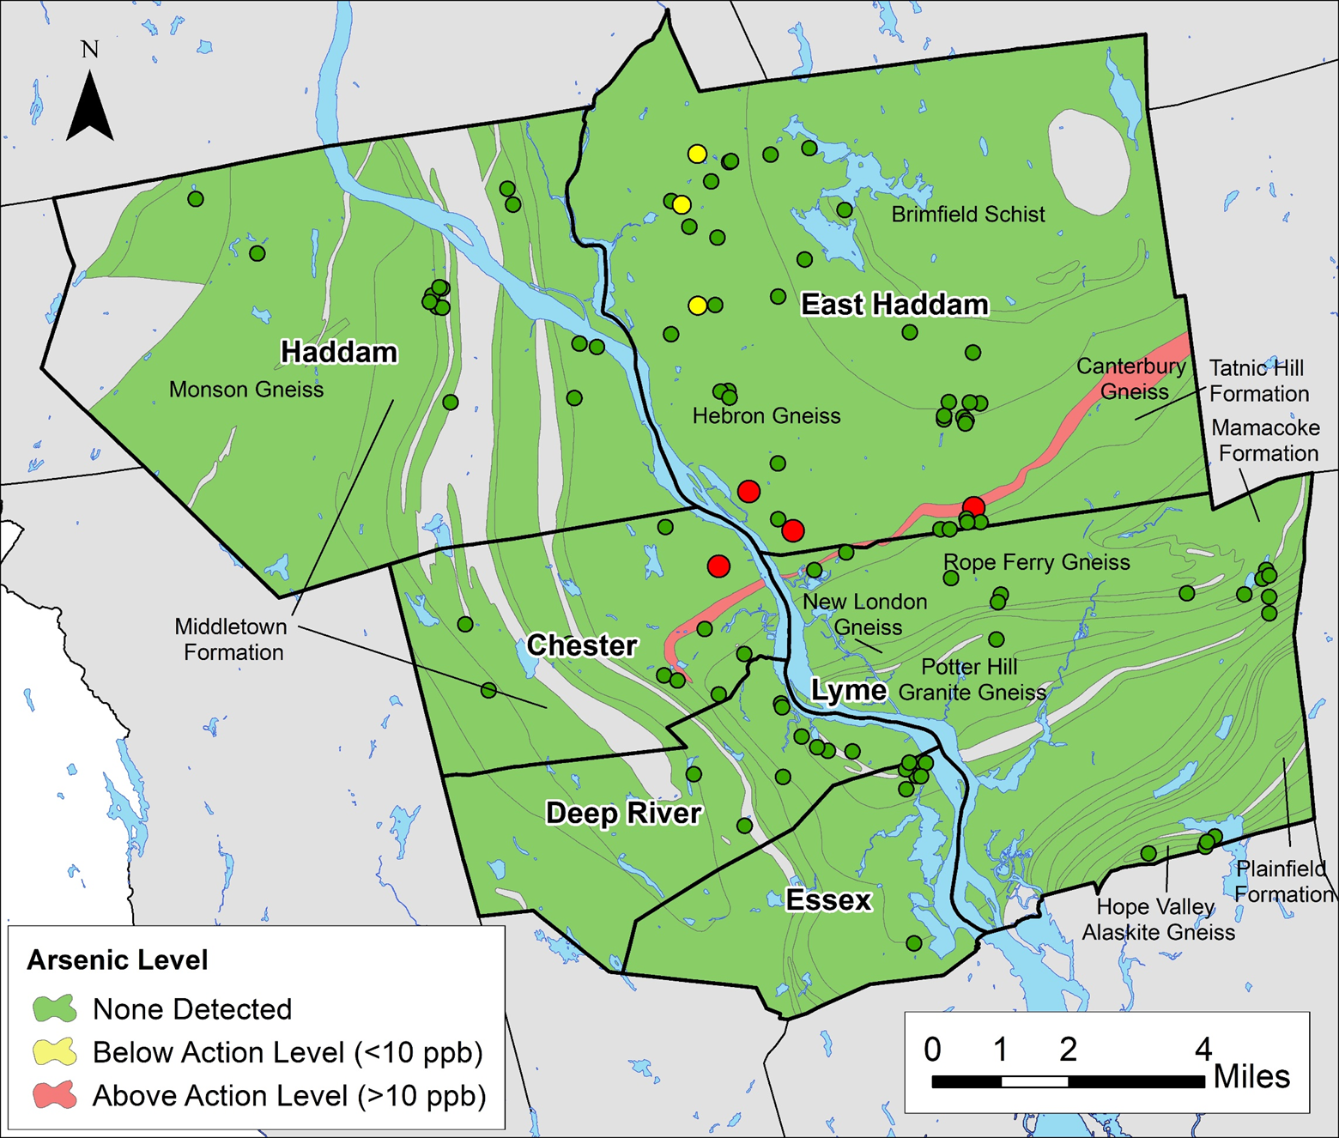
Arsenic Concentrations per Lithology
Conclusions
31% of wells intersected the Hebron Gneiss
Average arsenic concentration
No clustering spatially at the 95% confidence interval.
Results
Methods
Objectives
Background

Slide 19
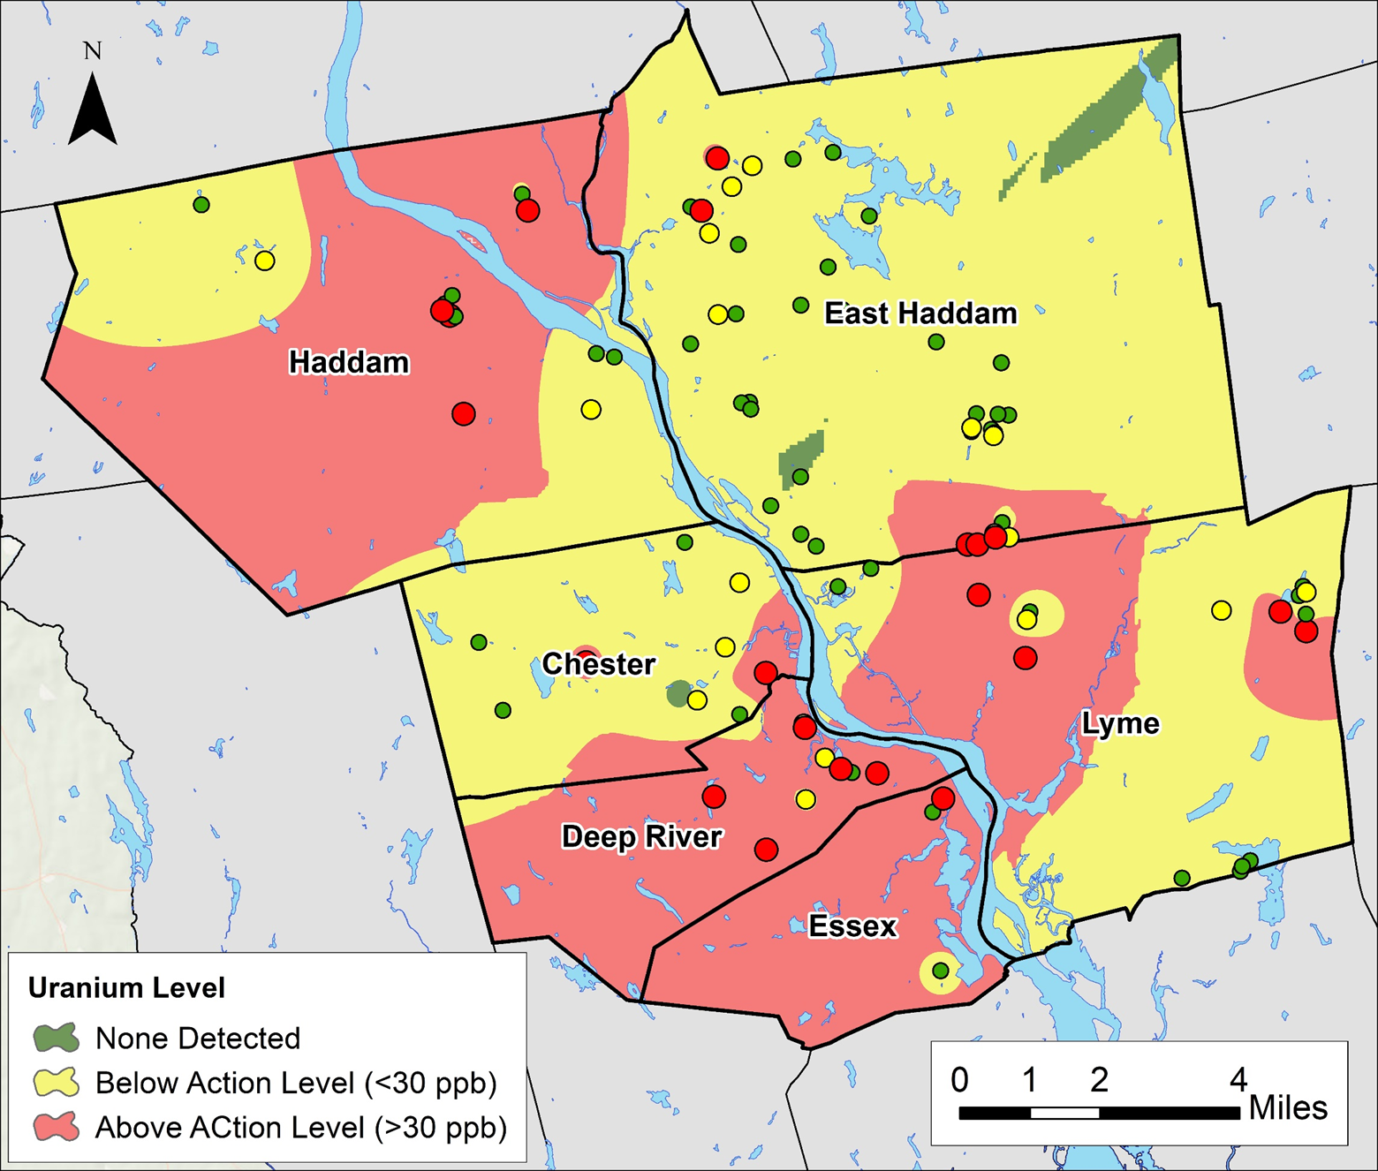
Uranium Distribution
Conclusions
Uranium Concentrations:
Minimum: non-detect
Maximum: 62 ppb
Average: 4.2 ppb
21% above the drinking water standard
17% within range
Results
Methods
Objectives
Background

Slide 20
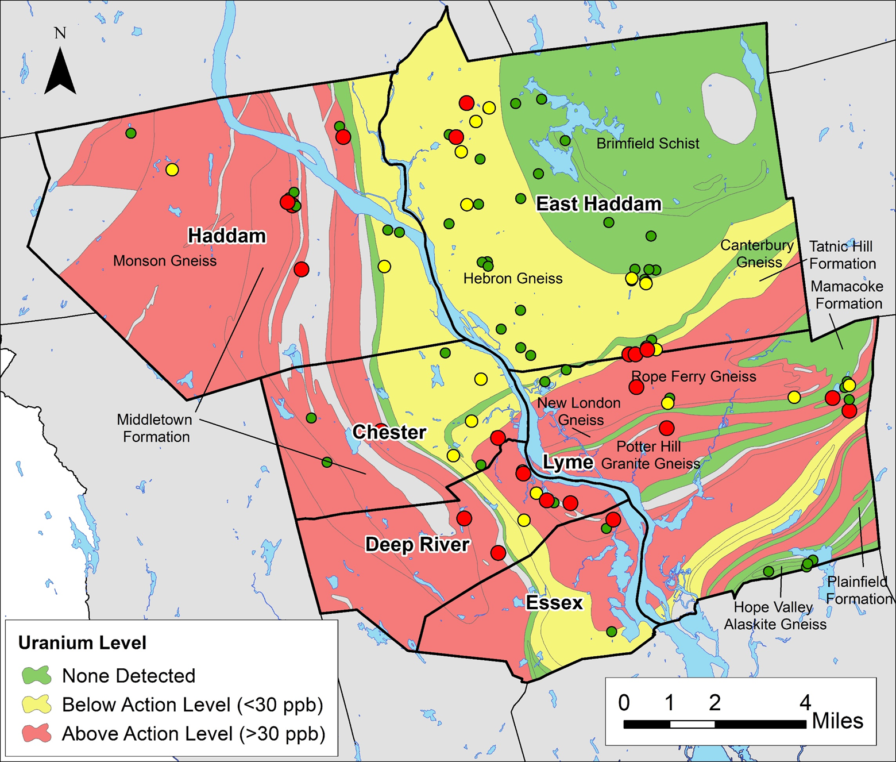
Uranium Concentrations per Lithology
Conclusions
No clustering at 95% confidence interval.
Results
Methods
Objectives
Background

Slide 21
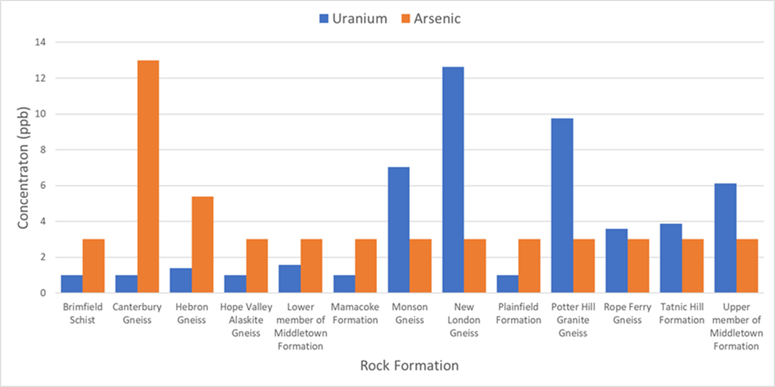
Arsenic and Uranium by Lithology
Conclusions
Highest average arsenic concentration in the Canterbury Gneiss, followed by the Hebron Gneiss.
Highest average uranium concentration was the New London Gneiss
Results
Methods
Objectives
Background

Slide 22
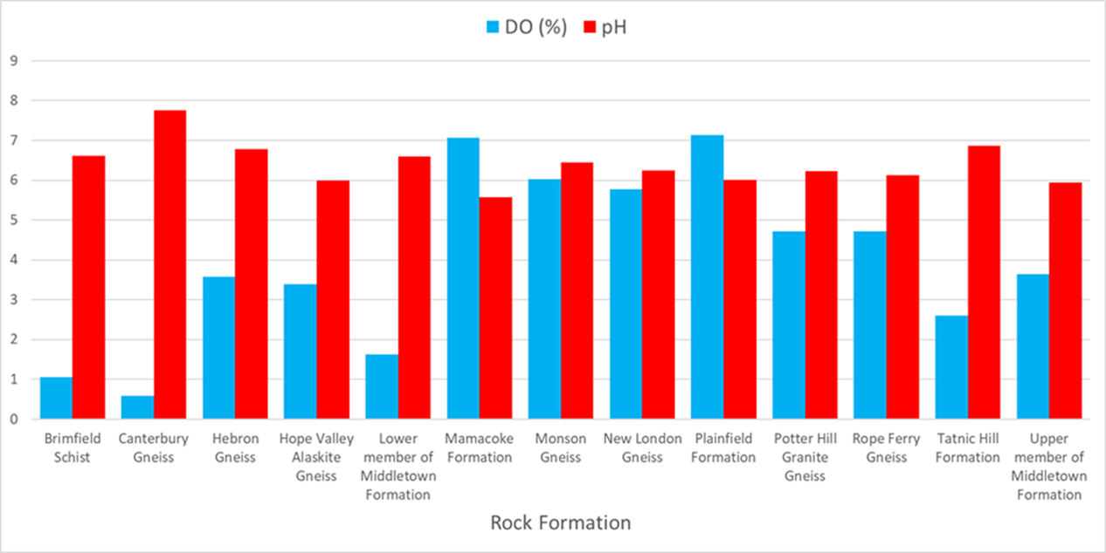
pH by Lithology
Conclusions
Neither arsenic nor uranium coincided with high pH values.
Higher pH values occurred in the central to northeast regions of the Quad, but values were within the acceptable range for drinking water.
Results
Methods
Objectives
Background

Slide 23
DO by Lithology
Conclusions
Occurrences varied greatly
Supports previous studies which have linked lower DO values to lower concentrations of uranium.
Results
Methods
Objectives
Background

Slide 24
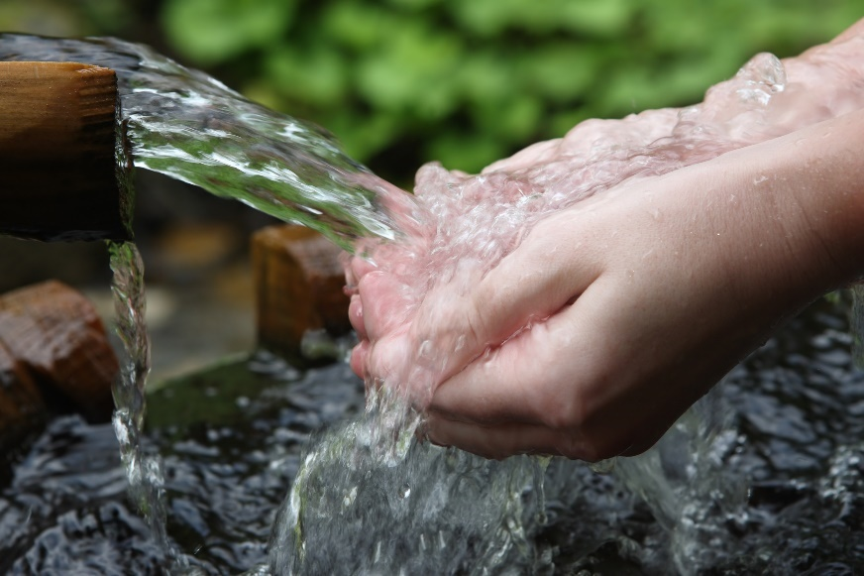
Conclusions
Conclusions
Unlike previous studies, results suggest presence of arsenic in fractured bedrock wells may not be associated with geology.
Uranium occurrences supported previous studies.
Background water quality conditions and influences by humans may be contributing to the complexity of the issue.
Occurrences appear to be randomly distributed.
Results
Methods
Objectives
Background

Slide 25
Going Forward (Arsenic)
Conclusions
Due to lack of influence on contaminant concentration by rock type, human and surficial influences must be analyzed to better understand
One suggestion would be to analyze the historic and current locations of orchards within the state.
Have previously been proven to coincide with large concentrations of arsenic due to heavy use in fertilizers.
Results
Methods
Objectives
Background

Slide 26
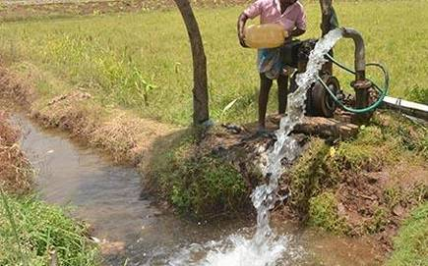
Going Forward (Uranium)
Conclusions
Further analysis should focus on occurrences through a larger scale.
As uranium is a naturally occurring element, a larger view of such occurrences across Connecticut as a whole, could prove to be helpful in drawing conclusions on occurrences within the Quadrangle.
Results
Methods
Objectives
Background

Slide 27
Going Forward
Conclusions
Extremely complex, more research on an individual well basis is needed to understand these observed occurrences. Can study:
Orientation and width of fractures
Concentrations of arsenic and uranium within each fracture (as opposed to an average)
Flow conditions
Results
Methods
Objectives
Background

Slide 28
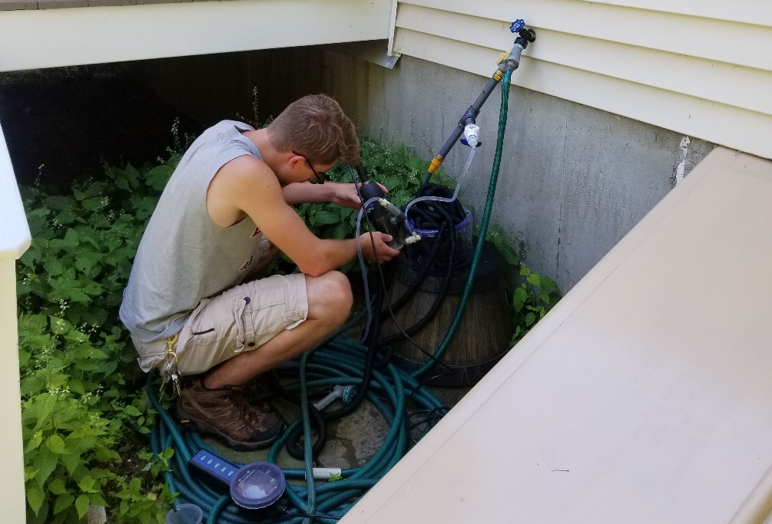
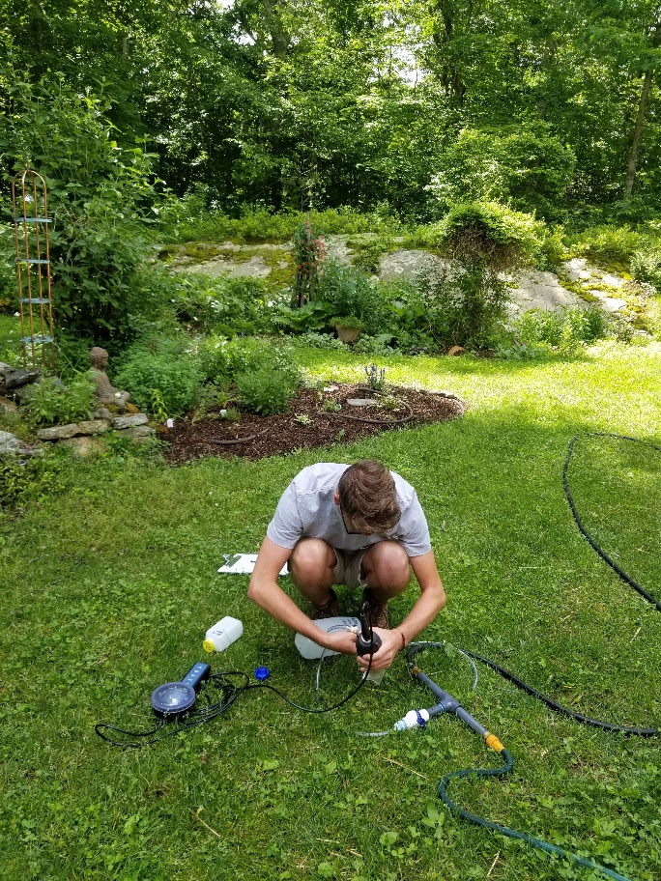
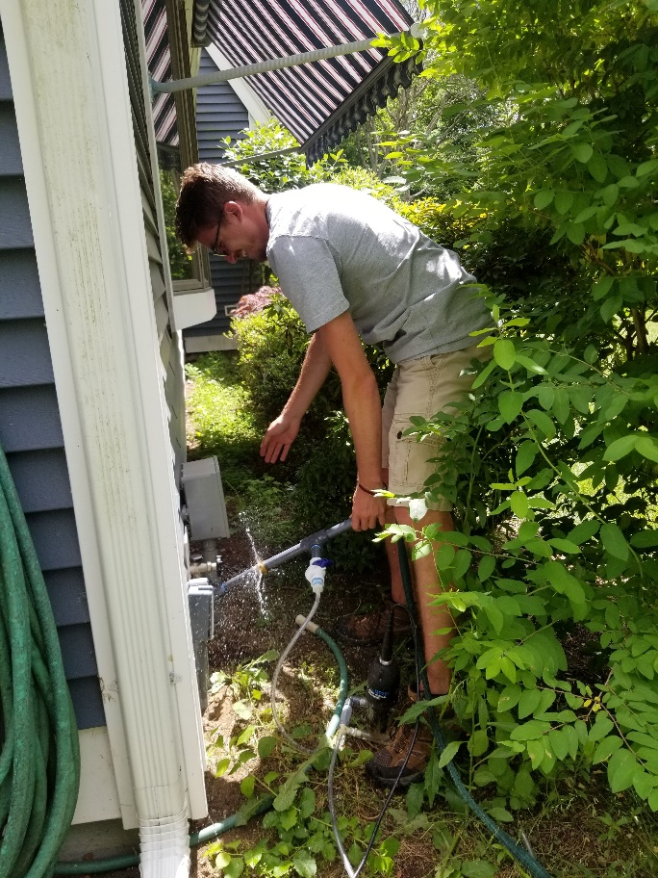
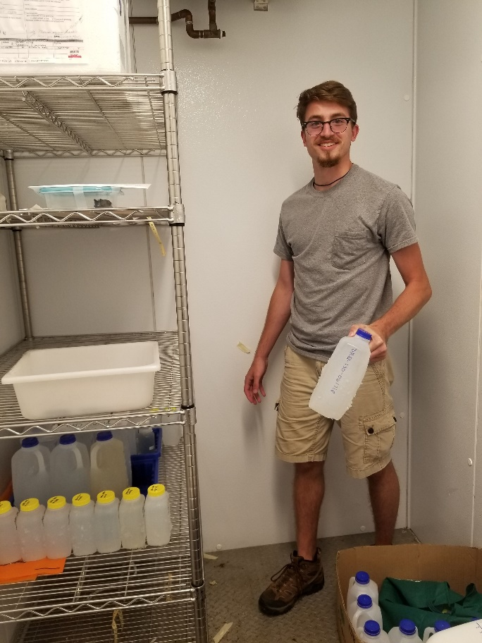
Thank You! Questions?

